Slide 1
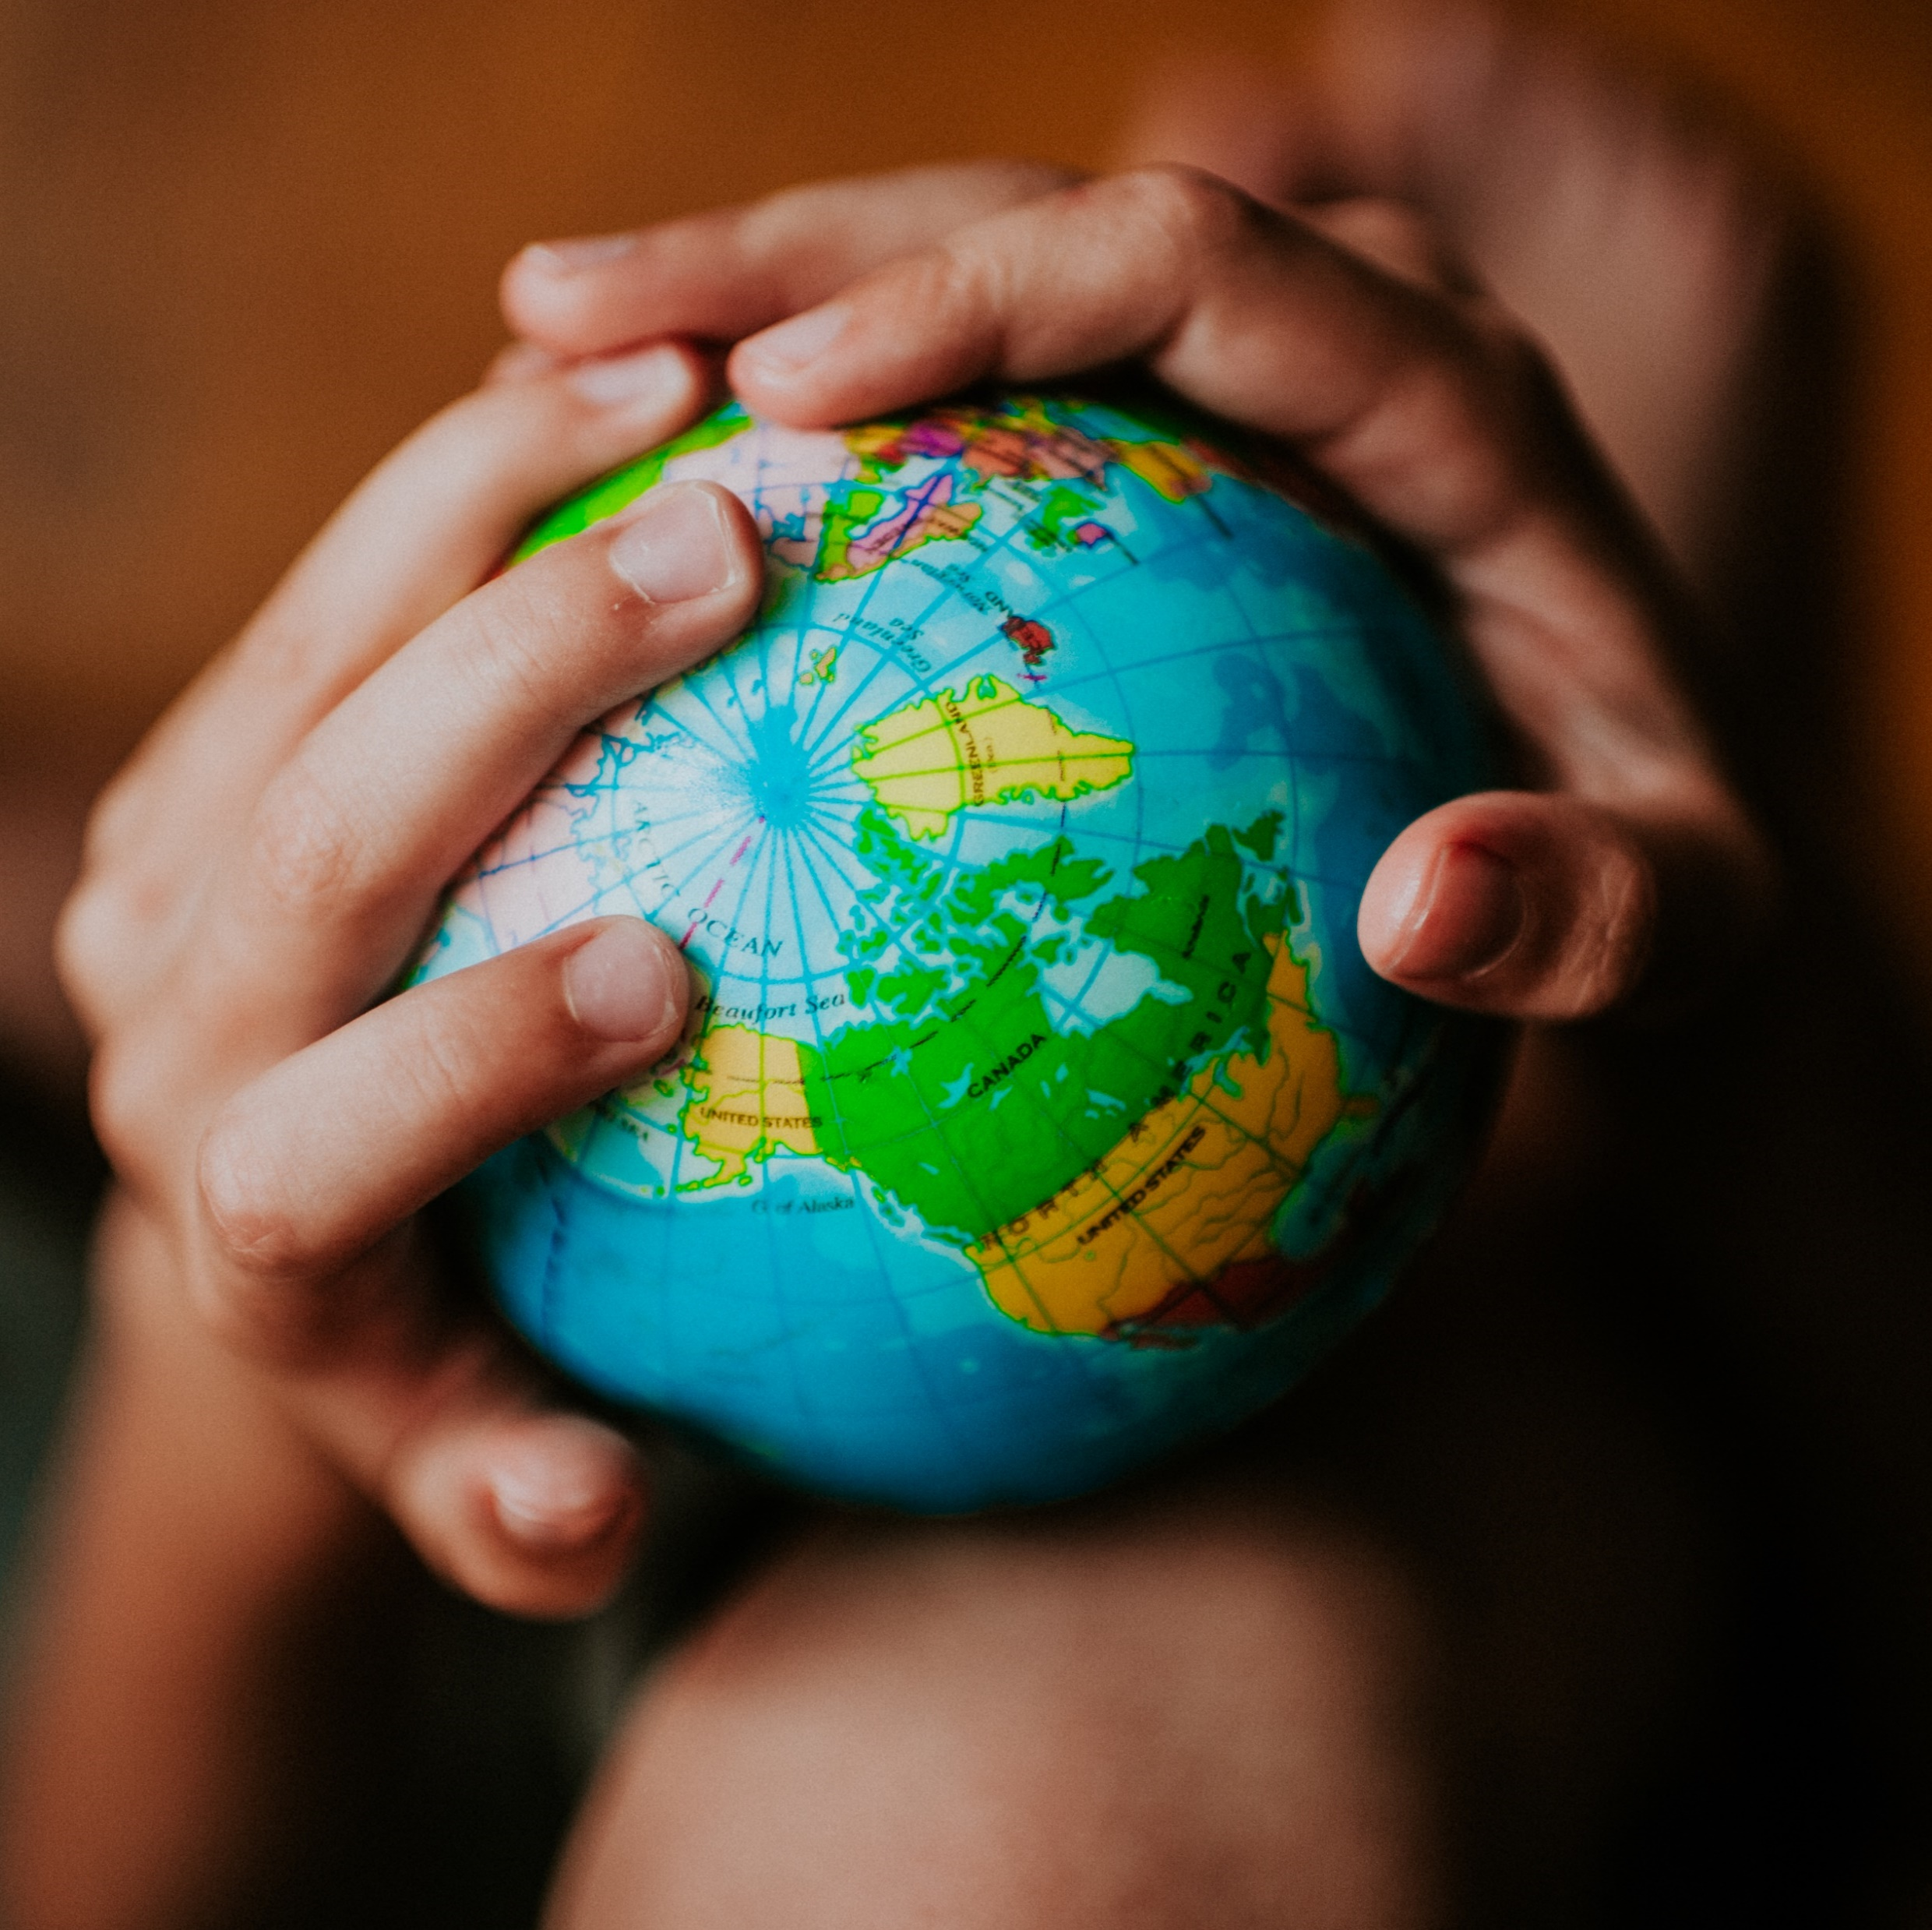
Welcome
Global health
Session 3
SDGs and Health
Dr. Tilly Paz

Slide 2

In this session you will:
Explore the idea behind having global development goals
Understand how the SDGs are linked with global health
Make some progress with your assessment

Slide 3

Sustainable Development Goals

Slide 4
First, what were the MDGs?

Slide 5
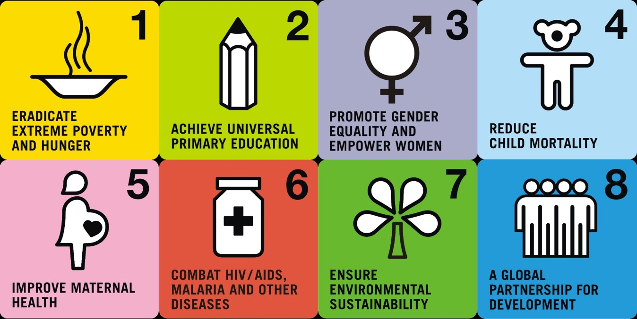
Millennium Development Goals (MDGs)
(2000 – 2015)
What is “Health” about them?
8 goals focused on global poverty reduction
Notes:
http://www.un.org/millenniumgoals/news.shtml.

Slide 6

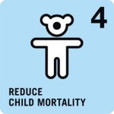

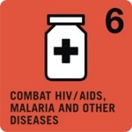

Millennium Development Goals (MDGs)
Examples of Achievements
The number of people living in extreme poverty (<$1.25 per day)
decreased from 1.9 billion to 836 million (1990-2015)
The number of children dying before their 5th birthdays
decreased from 12.7 million per year to 6 million (1990-2015)
The maternal mortality rate decreased by 44% (1990-2015)
The number of new cases of HIV each year decreased by 45% (2000-2015)
About 2.6 billion people gained reliable access to safe drinking water sources and 2.1 billion gained access to a toilet (1990-2015)
8 goals focused on global poverty reduction
Notes:
Think epidemiology about the data. What’s wrong with them?

Slide 7
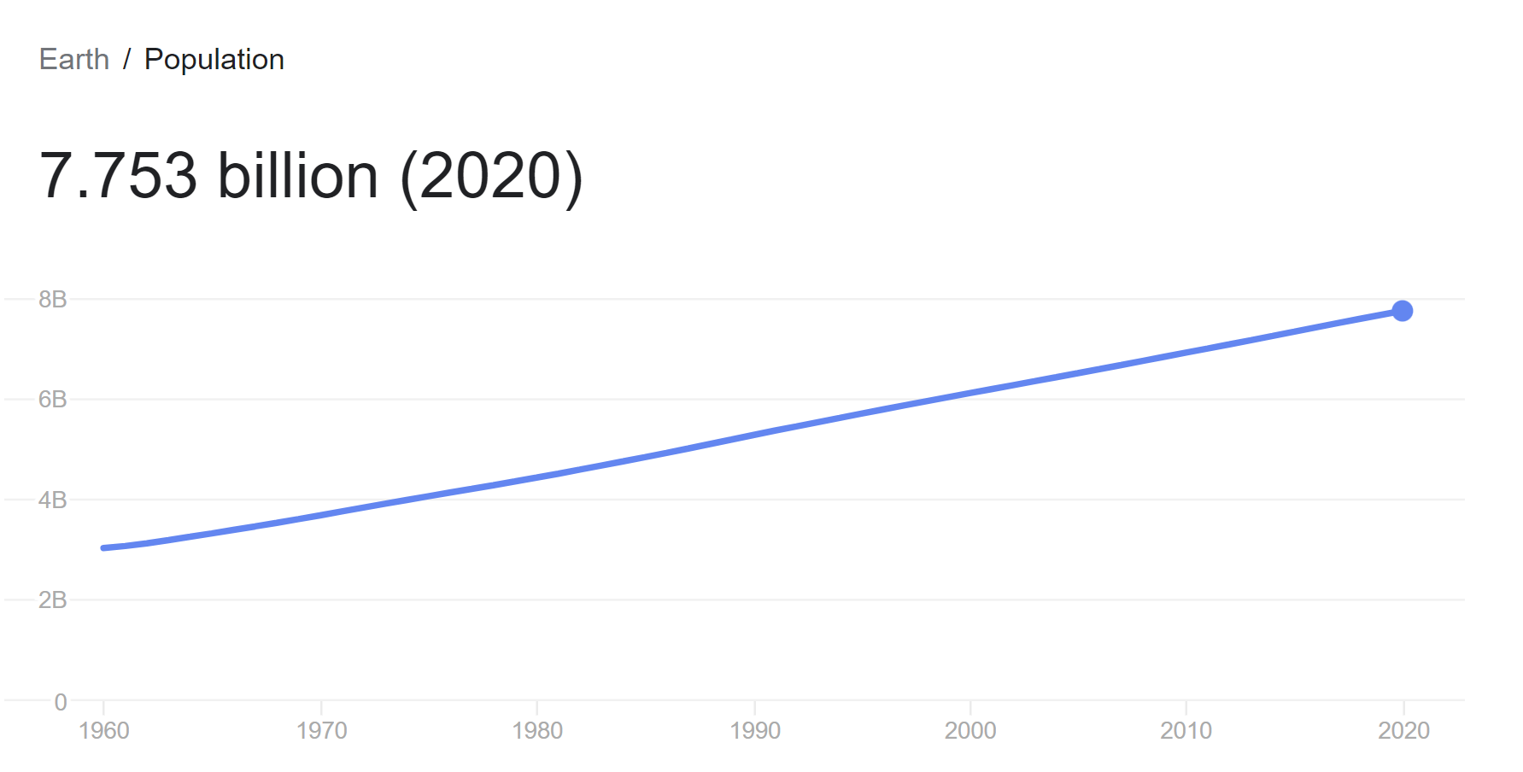

Slide 8
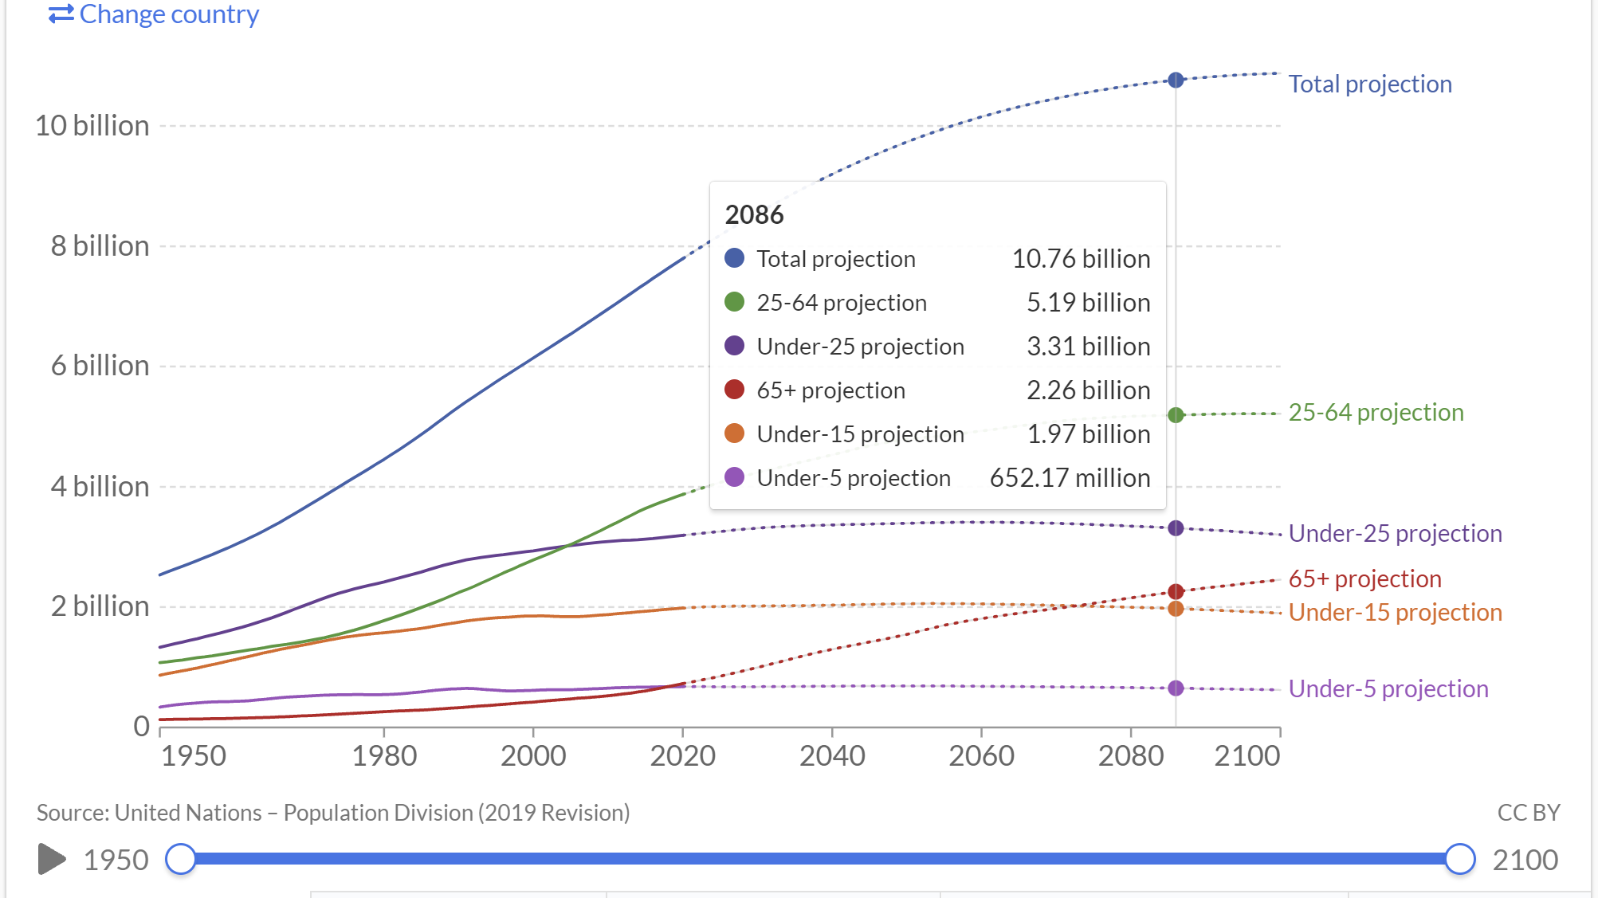
https://ourworldindata.org/population-aged-65-outnumber-children

Slide 9
Thinking of data
Children mortality
https://www.who.int/data/gho/data/themes/topics/topic-details/GHO/child-mortality-and-causes-of-death
Maternal mortality
https://www.who.int/news-room/fact-sheets/detail/maternal-mortality

Slide 10

Millennium Development Goals (MDGs)
(2000 – 2015)
8 Goals
21 Targets (sub-goals)
60 Indicators (metrics)
8 goals focused on global poverty reduction
Notes:
http://www.un.org/millenniumgoals/news.shtml.

Slide 11
What are the SDGs?

Slide 12

Sustainable Development Goals (SDGs)
(2016 – 2030)
What are the advantages and disadvantages of having more of everything?
17 Goals
169 Targets (sub-goals)
230 Indicators (metrics)
17 goals that apply to all countries
Notes:
http://www.un.org/millenniumgoals/news.shtml.

Slide 13
Sustainable Development Goals (SDGs)
(2016 – 2030)
build on the poverty reduction achievements under the MDGs
+
pursue new goals that
apply to all countries
Doesn’t poverty apply to all countries as well?
17 goals that apply to all countries
Notes:
http://www.un.org/millenniumgoals/news.shtml.

Slide 14
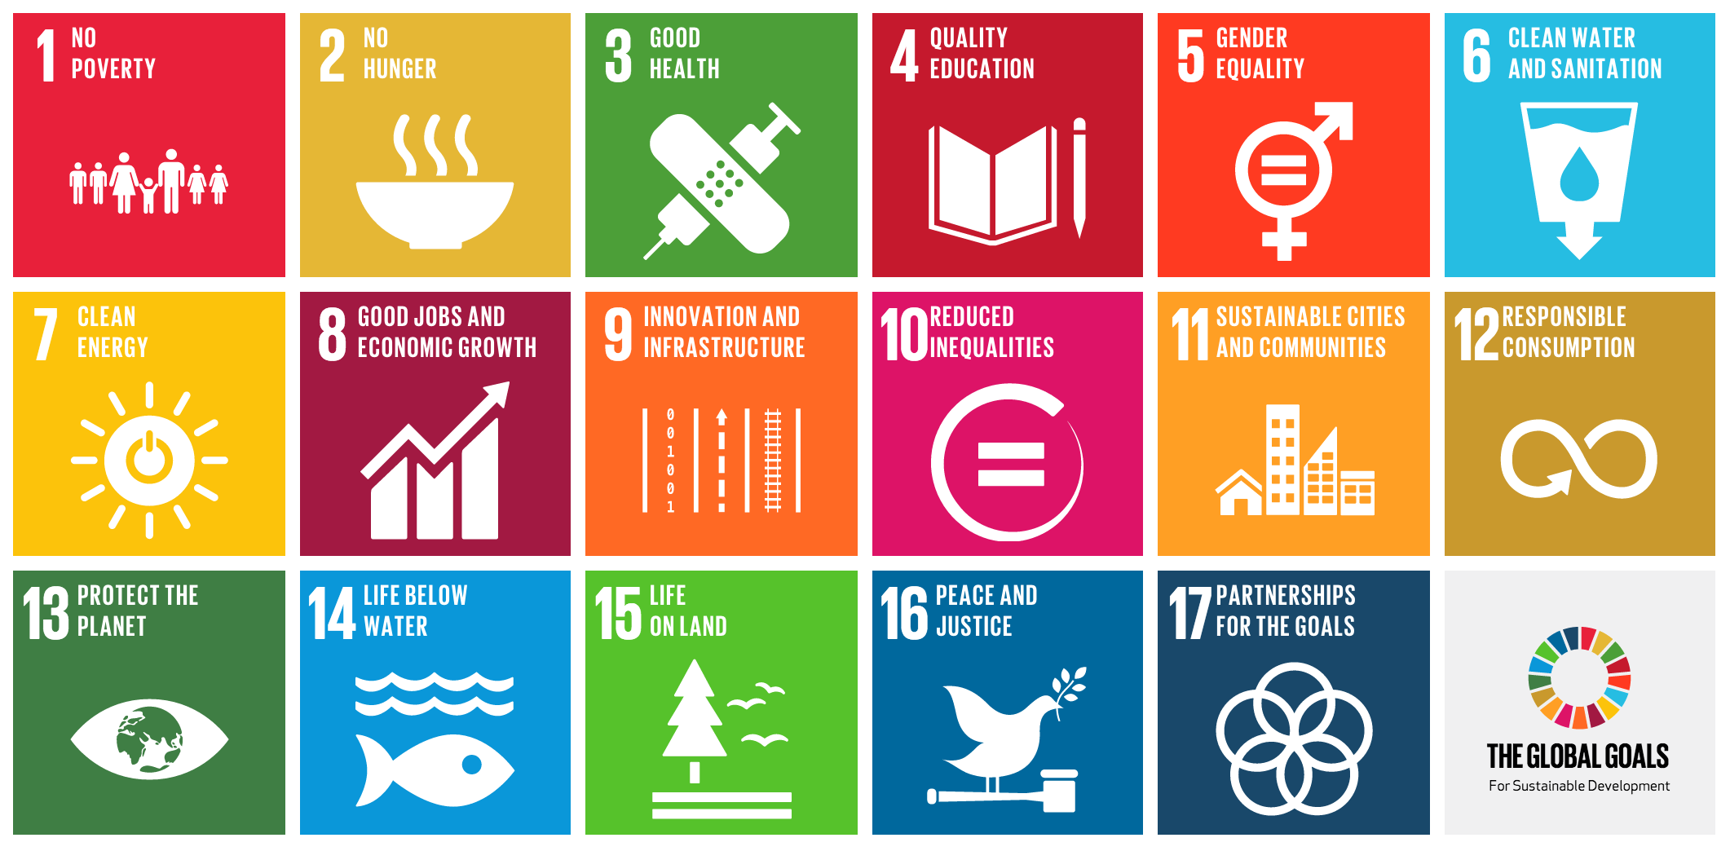
17 GOALS (2016–2030)
Notes:
The SDG images are from the United Nations.
Guidelines for use: http://www.un.org/sustainabledevelopment/wp-content/uploads/2016/09/UN-Guidelines-for-Use-of-SDG-logo-and-17-icons.September-2016.pdf

Slide 15
Sustainable Development Goals (SDGs)
(2016 – 2030)
A wide diversity of SDG metrics
will be reported every year by every country
Progress toward meeting national, regional, and global goals can be easily tracked over time
Why do we do that?
How is it important for your assessment? Hint – think CRAAP
17 goals that apply to all countries
Notes:
http://md.one.un.org/content/dam/unct/moldova/img/press/Infographic_five_elements.png

Slide 16
The SDGs and Health (Play with the link, it’s fun!)

Slide 17
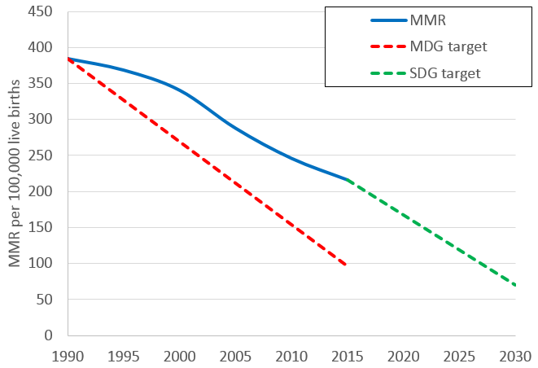
MATERNAL MORTALITY
MDG target NOT MET

Slide 18
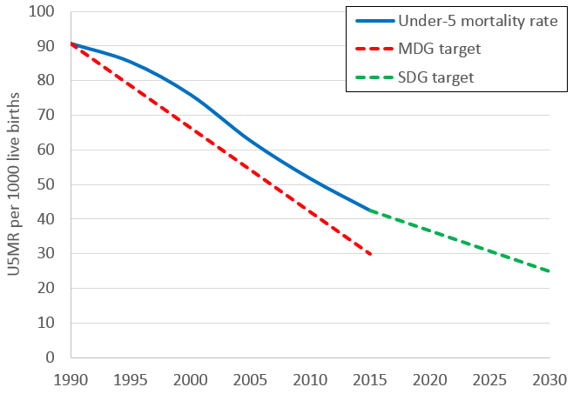
UNDER-5 CHILD MORTALITY
MDG target NOT MET

Slide 19
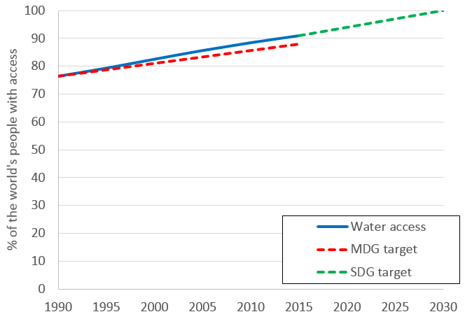
WATER
MDG target MET

Slide 20
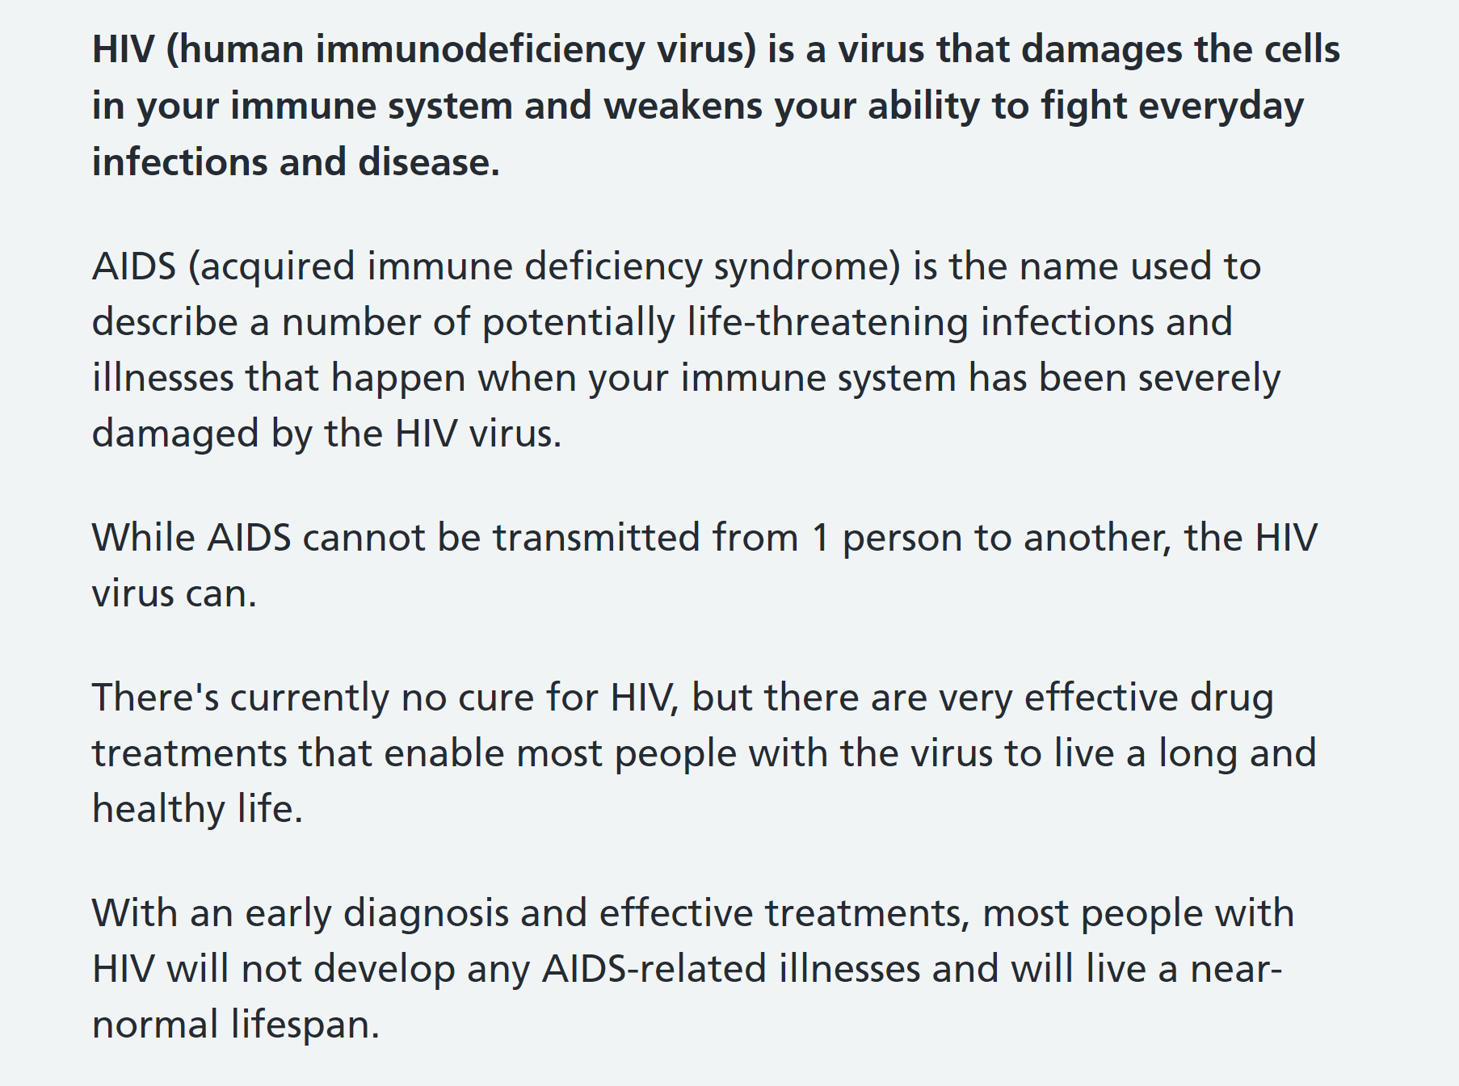

Slide 21
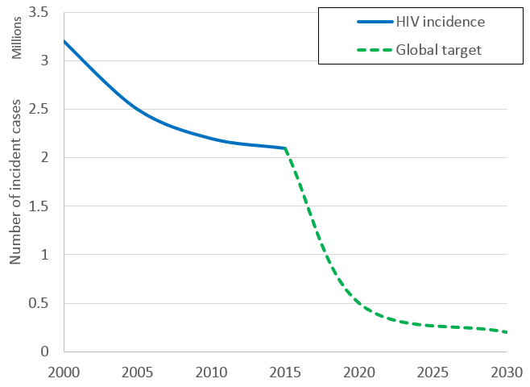
HIV/AIDS: Incidence (new infections per year)
Progress since 2000
Goals through 2030

Slide 22
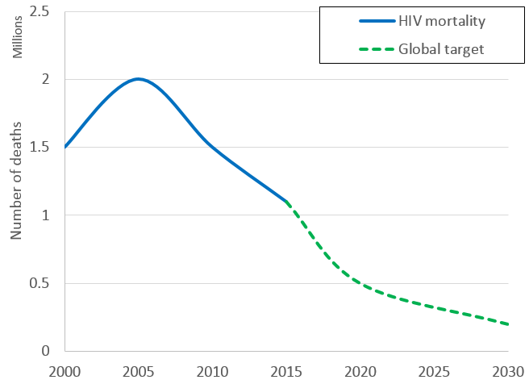
HIV/AIDS: Mortality (total deaths per year)
Changes since 2000
Goals through 2030

Slide 23
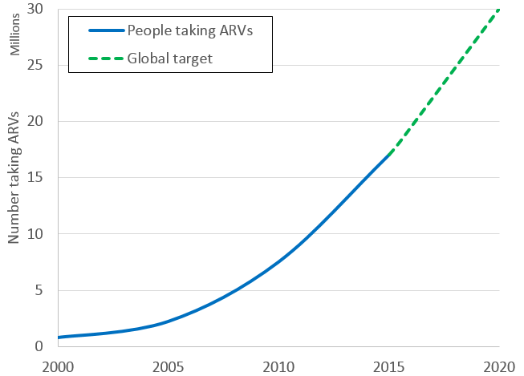
HIV/AIDS: Treatment (people with HIV taking ARVs)
Ambitious goal for 2020
Major progress since 2000
(“15 x 15”)

Slide 24
Other global data about HIV
https://www.unaids.org/en/resources/fact-sheet

Slide 25

Progress with essays
What have you done? Any questions?
Is your case recent? Is it well linked with health?

Slide 26

See you next week
We will dive into the world of globalisation, play with some props and debate an important question
Do your work and be on time, ready to rock

